Slide 1
Presentation Bachelor Thesis Building a ROS2-VLA Bridge
Samuel Rochlitzer
13.11.2025

Slide 2
Presentation Structure
Introduction
Fundamentals & Bridge
Implementation
with implementation methods
Experiments
with experimental methods
Results
Discussion
Outlook & Future Work

Slide 3
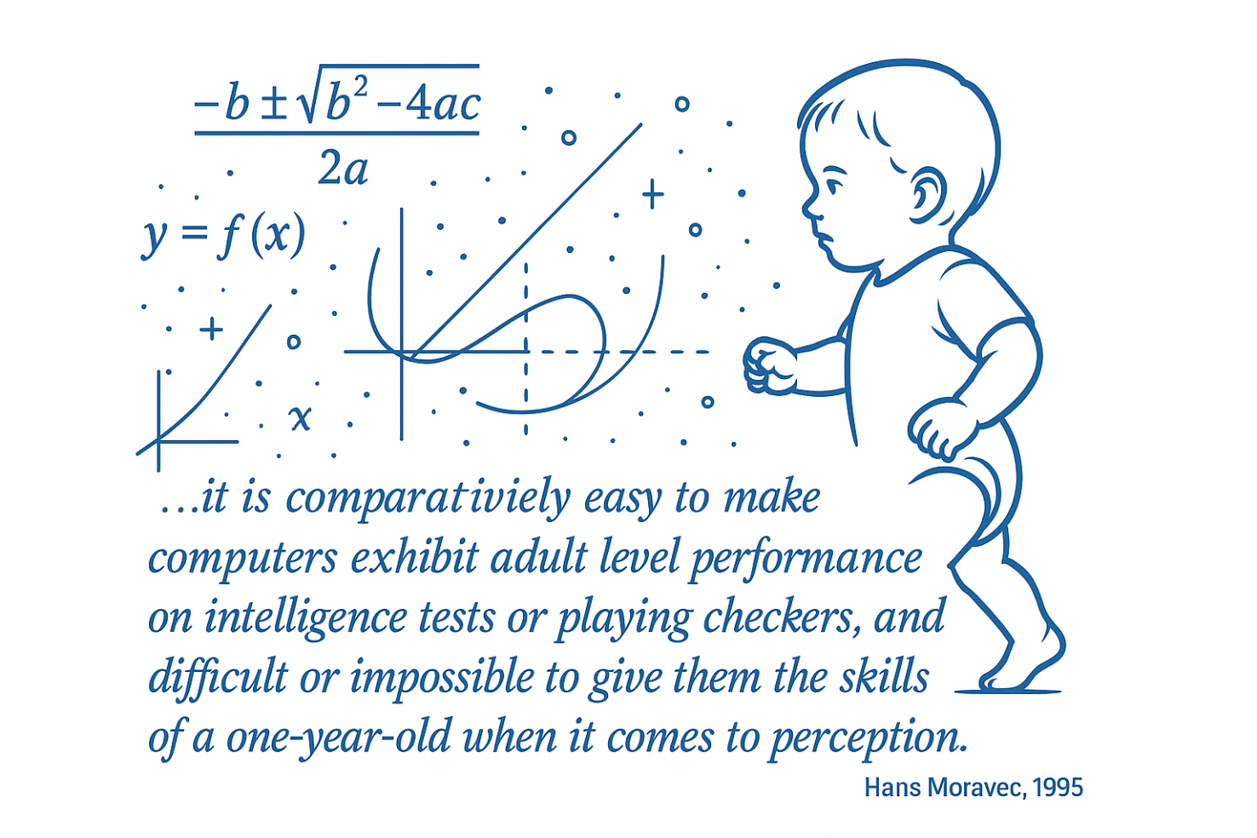
Intro
AI hype
chatbots like chat-GPT
Not the first time “AI-Winter”
Real-world complexity
Morvac‘s Paradox:

Slide 4
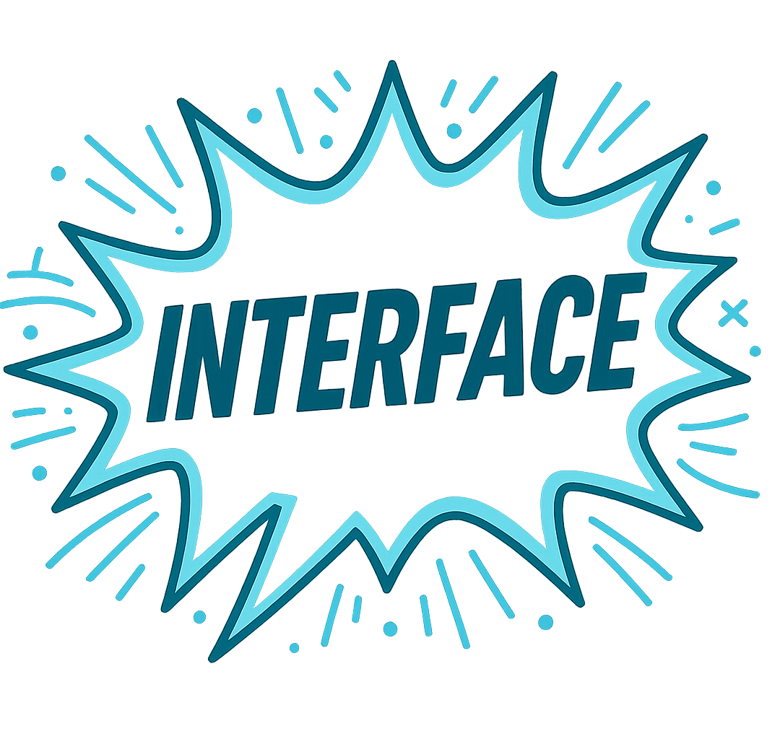
Intro: Motivation
Large AI-models handling complexity
Potential in new deployment
Integration difficult:
mostly low-level deltas
no guarantees, black-box
fast development and iteration
breaking with existing principles
Problematic for:
established complex systems
combination with existing components

Slide 5
Intro: Problem Statement
What should this interface look like?
definition
abstraction
data required
Building a ROS2-VLA Bridge
Evaluation
design
function
performance*
*testing communication performance (no working model available)

Slide 6
Fundamentals: History
Robot Operating System
1998 Layerd architecture SPA
2010 introduction of ROS
2017 transition to ROS2
Transformer based AI
2019 Large Language Models
2023 Vision Language Models
2024 Vision Language Action Models

Slide 7
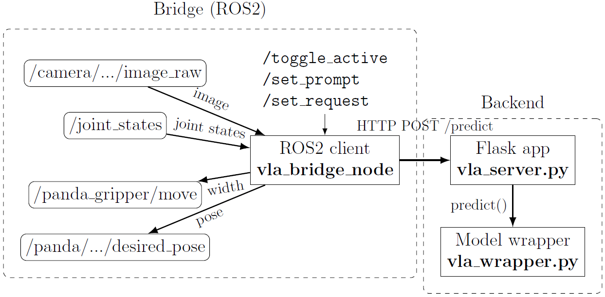
Proposed Bridge
Separated client-server design
Main interface /predict route

Slide 8
Contributions
ROS2 client node vla_bridge_node.py
Backend
Flask application vla_server.py
model wrapper vla_wrapper.py
Interfaces package for runtime control
/toggle_active
/set_prompt
/set_request
Deployment environments
Dockerfile
environment.yml

Slide 9
Scope
Development of a ROS2-VLA Bridge
Focus on the bridge client package
Existing hardware packages fully functional
We assumed OpenVLA would perform reasonably well
Further VLA finetuning or evaluation out of scope!
Notes:
Bullet points!

Slide 10
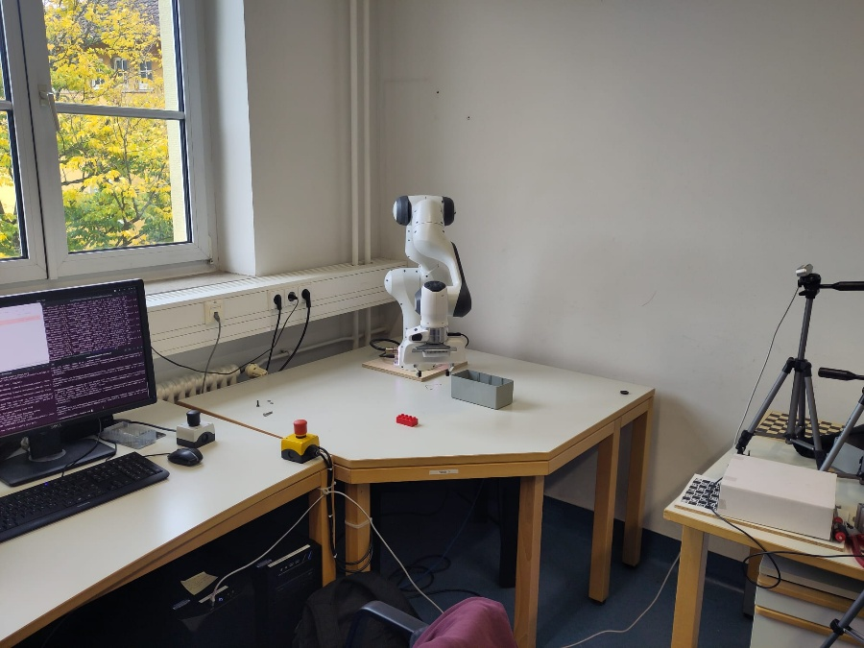
Implementation: Hardware
Franka Emika Panda robot arm
multimode_franka driver package controlled via
/panda/panda_cartesian_impedance_controller/desired_pose
Intel Realsense camera
realsense2_camera_node publishing to
/camera/realsense2_camera/color/image_raw
Host system
Ubuntu 22.04
NVIDIA® GeForceRTX™ 5090 GPU

Slide 11
Software: Communication
requests python module
/predict Flask route using
sending HTTP with payload and backend_url
payload (.json)
natural language prompt
joint states (not used by OpenVLA)
image (base64 encoded)
model name to be used

Slide 12
Software: Bridge (ROS2)
vla_client (pkg)
vla_bridge_node.py
data fields kept up to date by callback functions
request loop timer
service call functions
send_request() function structured with many helpers
launch_all.launch.py
loading parameters from real.yaml
launching franka_bringup and and realsense2_camera_node
vla_interfaces (pkg)
defining service messages for /set_prompt and /set_request
Notes:
Groß/klein

Slide 13
Software: Backend
vla_server.py
instantiating the wrapper loading the model
offering /predict route
decoding payload and image
offering the debugging image view
calling the predict() on requests
vla_wrapper.py
model specific load_model()
model specific preprocessing
performing inference in predict()
returning dict with deltas and meta data

Slide 14


Software: Deployment environments
ROS2 image
using Docker software
create the image using build
run container with run
ready to launch
Backend environment
create the Conda environment(.yaml)
activate it
run vla_server.py

Slide 15

Experiments
34 runs recorded
Hard-coded
verification with constant deltas
testing translation, rotation and gripper
communication overhead
Finetuning
full-stack testing
minimal, task specific training
Base-model
no finetuning
comparison to default prompt

Slide 16
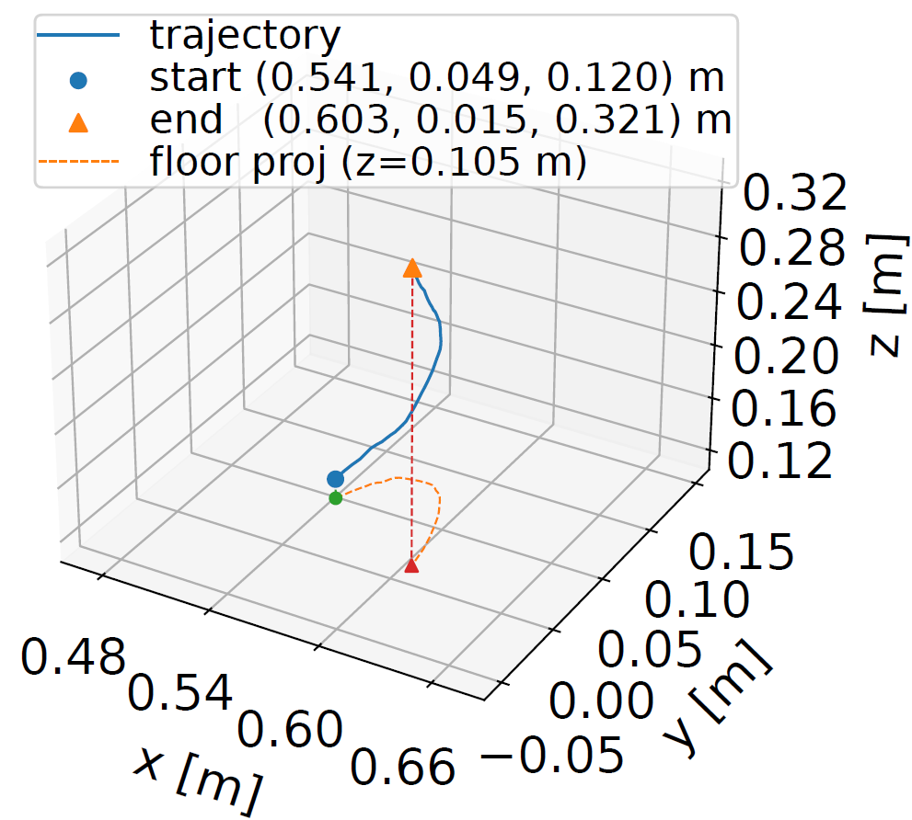
Results: Hard-coded
Translation
drift in other dimensions
total distance less than expected
Example (record01)
prompt: “HARD: go up”
delta_z = 0.01 m
request_interval = 1 s
0.5 m translation upwards expected
Figure
produced by eval.py
in repo at logs/eval_out/figs
traj3d_record01_1Hz_go_up.pdf

Slide 17
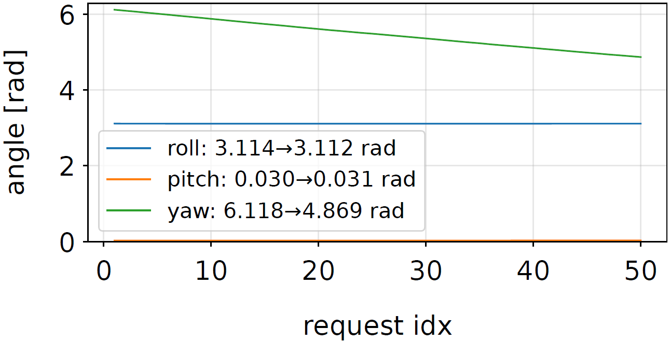
Results: Hard-coded
Rotation
depending on rotation axes
positional drift
rotational drift
more or less stable positions
Visualization
3D rotation difficult to visualize
axes specific rotation relevant
plotting rol, pitch and yaw per step
Example (record03)
task “…yaw right” at 1 Hz
yaw produced the cleanest rotation

Slide 18
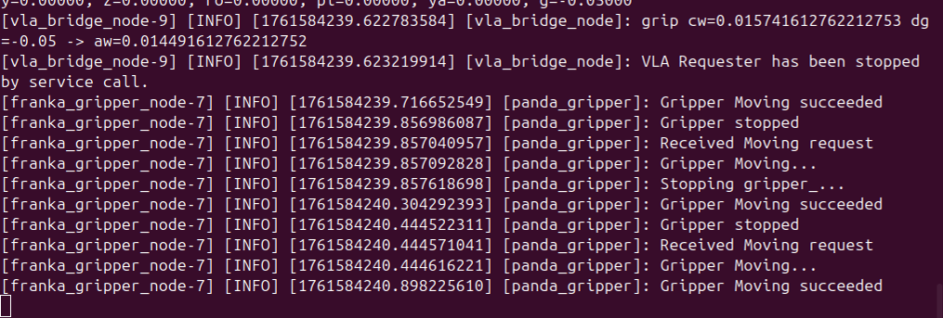
Results: Hard-coded
Gripper
/move action very slow
logs show roughly 1 action per second
otherwise lagging behind even after deactivating requests

Slide 19
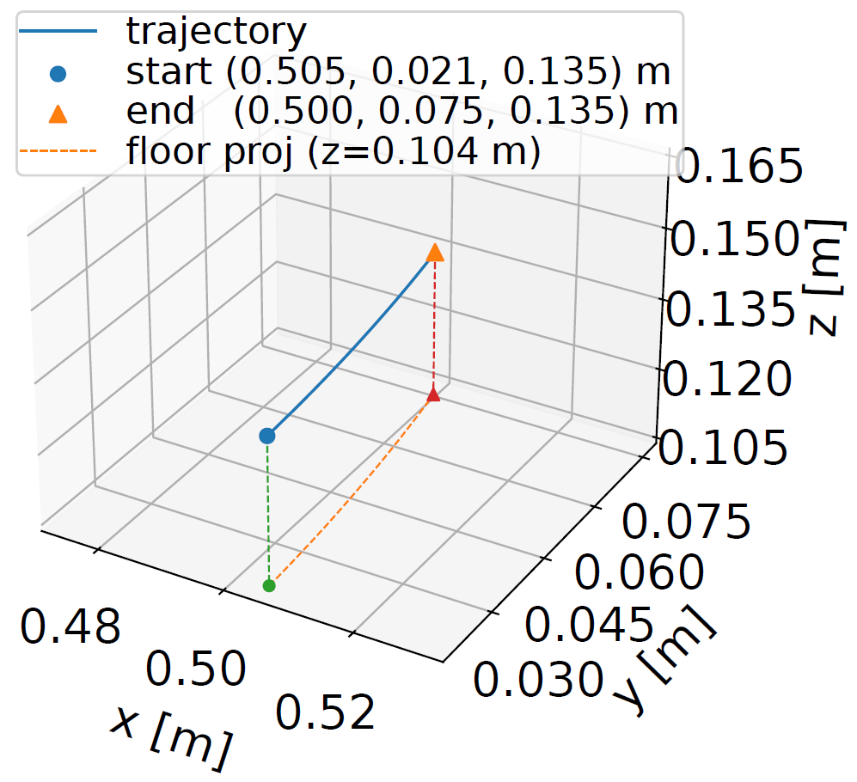
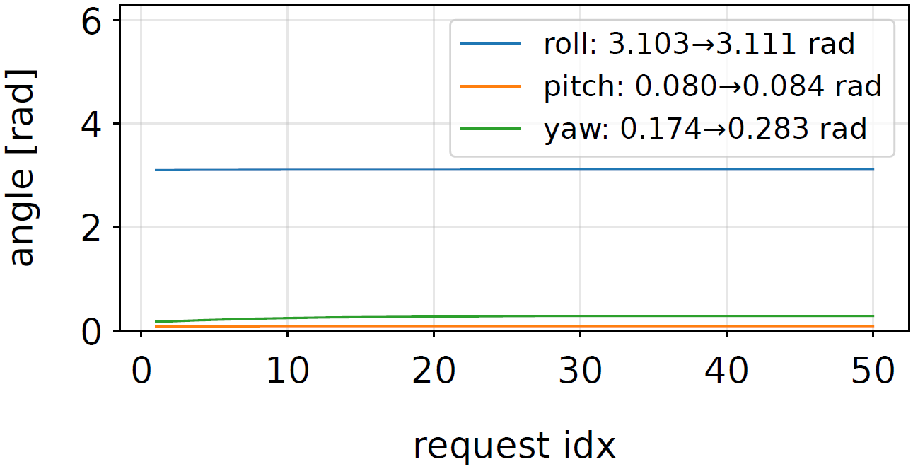
Results: Finetuning
Setting and task specific data for training
Very little (if any) movement observed
Task “put the duplo brick into the box” at 2 Hz
Backend returning only miniscule deltas
figures: …record21_2Hz_duplo.pdf

Slide 20
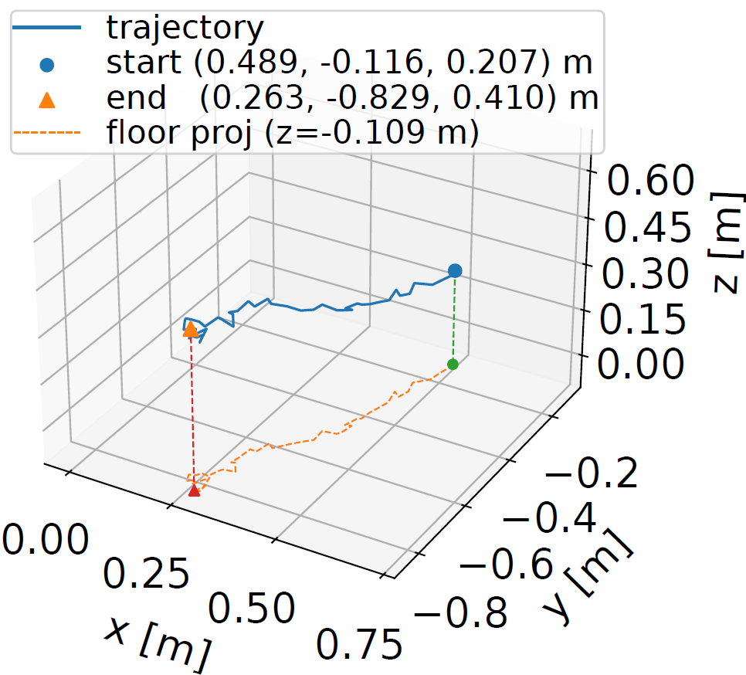
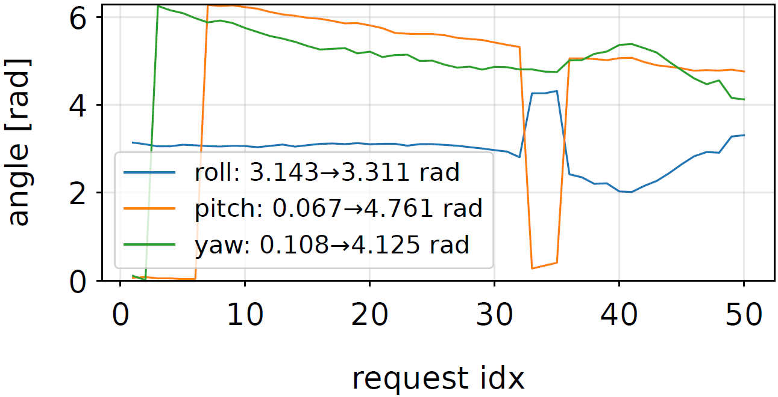
Results: Base-model
No local finetuning directory used
Movements arbitrary (not task orientated)
Similar results using the default prompt
…record34_2Hz_cube_no_finetuning.pdf

Slide 21
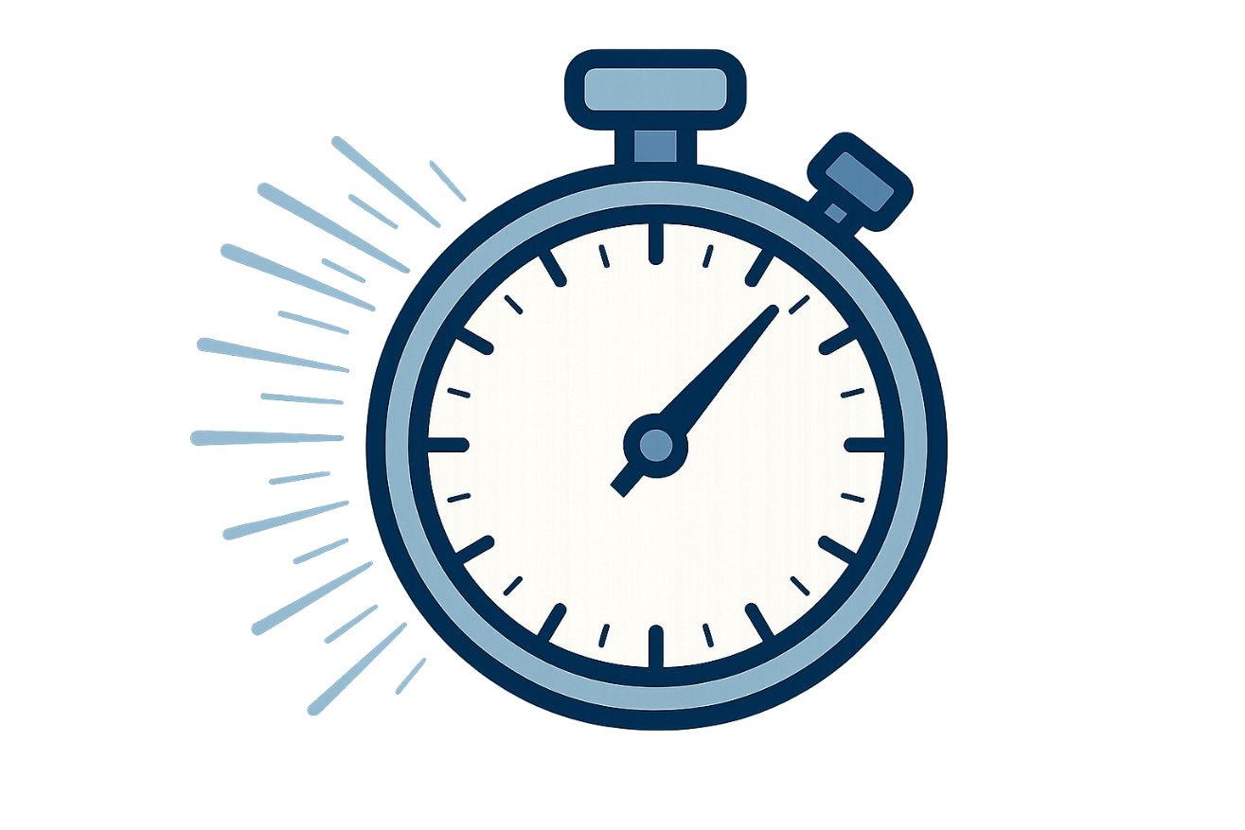
Results: Latency
Records include timestamps
Communication-Overhead
hard-coded p95(e2e) < 10 ms
most of it outbound
Inference
no difference using finetuning dir
backend inference ca. 150 ms
Overlap
gripper action problematic
1 Hz none
5 Hz significant
2 Hz minimal (sweet spot)

Slide 22
Discussion: Bridge
Hard-coded tests verify communication and limited control
Full-stack testing showed:
request-loop established
loading of model and local finetuning files feasible
Communication-overhead low
Inference rate up to 5 Hz possible
Controller struggle to keep up
Modular architecture allowing:
other backend models
external hosting of VLA

Slide 23
Discussion: Limitations
Major control inaccuracies
Gripper action too slow
Clash of paradigms
VLA not working:
no task completion
OpenVLA-7b base model does not generalize
our minimal finetuning attempt failed
bad training or data
different camera perspective or calibration
very difficult to debug a black-box
Further VLA-training or finetuning was out of scope!

Slide 24
Outlook & Future Work
The bridge although functional reveals friction
new/improved controller packages needed
applying deltas to current position insufficient
Evaluation with a working VLA
task success comparison
isolation of model and bridge specific faults
Conceptual tension
layered architecture vs. black-box
verified execution of action plan vs. reactive stochastic approach
are principles compatible?

Slide 25

Sources
Images
https://de.wikipedia.org/wiki/Conda_(Paketverwaltung)
https://de.wikipedia.org/wiki/Docker_(Software)
generated on https://chatgpt.com
Repository public at
https://github.com/aZamuel/ROS2-VLA_Bridge
External sources
in the following slides (s. thesis bibliography)

Slide 26
Sources
Anthony Brohan et al. RT-1: Robotics Transformer for Real-World Control at Scale. arXiv:2212.06817 [cs]. Aug. 2023. doi:10.48550/arXiv.2212.06817. url: http://arxiv.org/abs/2212.06817 (visited on 10/20/2025).
Jacob Devlin et al. “BERT: Pre-training of Deep BidirectionalTransformers for Language Understanding”. en. In: Proceedings ofthe 2019 Conference of the North. Minneapolis, Minnesota: Asso-ciation for Computational Linguistics, 2019, pp. 4171–4186. doi:10.18653/v1/N19-1423. url: http://aclweb.org/anthology/N19-1423 (visited on 08/25/2025).
Franka Robotics GmbH. Franka documentation. en. url: https://franka.de/documents (visited on 10/20/2025).
Erann Gat. “On Three-Layer Architectures”. en. In: (1998). url: https://flownet.com/gat/papers/tla.pdf (visited on10/20/2025).
Moo Jin Kim et al. OpenVLA: An Open-Source Vision-Language-Action Model. arXiv:2406.09246 [cs]. Sept. 2024. doi: 10.48550/arXiv.2406.09246. url: http://arxiv.org/abs/2406.09246 (visited on 08/25/2025).
Haotian Liu et al. “Visual Instruction Tuning”. In: Advancesin Neural Information Processing Systems. Ed. by A. Oh et al.Vol. 36. Curran Associates, Inc., 2023, pp. 34892–34916. url: https://proceedings.neurips.cc/paper_files/paper/2023/file/6dcf277ea32ce3288914faf369fe6de0-Paper-Conference.pdf.

Slide 27
Sources
Steven Macenski et al. “Robot Operating System 2: Design, ar-chitecture, and uses in the wild”. In: Science Robotics 7.66 (2022),eabm6074. doi: 10.1126/scirobotics.abm6074. url: https://www.science.org/doi/abs/10.1126/scirobotics.abm6074.
Hans Moravec. Mind children: the future of robot and human in-telligence. eng. 4. print. Cambridge: Harvard Univ. Press, 1995.isbn: 978-0-674-57618-6.
Matthias Mayr and Julian M. Salt-Ducaju. A C++ Implemen-tation of a Cartesian Impedance Controller for Robotic Manipu-lators. arXiv:2212.11215 [cs]. Dec. 2022. doi: 10.48550/arXiv.2212.11215. url: http://arxiv.org/abs/2212.11215 (visitedon 10/20/2025).
multipanda. tenfoldpaper/multipanda ros2. original-date: 2024-04-05T07:21:09Z. Sept. 2025. url: https://github.com/tenfoldpaper/multipanda_ros2 (visited on 10/20/2025).
Abby O’Neill et al. Open X-Embodiment: Robotic LearningDatasets and RT-X Models. arXiv:2310.08864 [cs]. May 2025. doi:10.48550/arXiv.2310.08864. url: http://arxiv.org/abs/2310.08864 (visited on 10/20/2025).
Rui Shao et al. Large VLM-based Vision-Language-Action Modelsfor Robotic Manipulation: A Survey. arXiv:2508.13073 [cs]. Sept.2025. doi: 10.48550/arXiv.2508.13073. url: http://arxiv.org/abs/2508.13073 (visited on 10/20/2025).

Slide 28
Sources
Mohit Shridhar, Lucas Manuelli, and Dieter Fox. CLIPort: Whatand Where Pathways for Robotic Manipulation. arXiv:2109.12098[cs]. Sept. 2021. doi: 10.48550/arXiv.2109.12098. url: http://arxiv.org/abs/2109.12098 (visited on 09/05/2025).
Ashish Vaswani et al. “Attention is All you Need”. In: Ad-vances in Neural Information Processing Systems. Ed. by I. Guyonet al. Vol. 30. Curran Associates, Inc., 2017. url: https://proceedings.neurips.cc/paper_files/paper/2017/file/3f5ee243547dee91fbd053c1c4a845aa-Paper.pdf.

